Slide 1


ACCIDENT PREVENTION AND RESCUE SYSTEM

Slide 2
STUDENT’S INTRODUCTION
PREPARED BY:-
NAME:PERIN MODI
ROLL NO:58
ENRLNO:2021002171210083
BATCH:B3
BRANCH:CSE
NAME:VARDHAN BHAVSAR
ROLL NO:53
ENRLNO:2021002171210013
BATCH:B3
BRANCH:CSE
NAME:DHARSHIT DHOLA
ROLL NO:67
ENRLNO:2021002171210028
BATCH:B3
BRANCH:CSE
NAME:VISHAL JADEJA
ROLL NO:66
ENRLNO:2021002171210047
BATCH:B3
BRANCH:CSE

Slide 3
INTRODUCTION
RESPECTED SIR/MADAM,
In this IOT Project we have created an ACCIDENT PREVENTION AND RESCUE SYSTEM using IRIS, GSM, Force and GPS sensor, button with Arduino UNO.

Slide 5
Roadmap
IF ACCIDENT HAPPEN
IF SOMEONE PRESSED BUTTON
IN EMERGENCY
GOT RESCUED
1
3
5
2
4
SENSE BY DHT, FORCE, IRIS SENSORS
SEND MESSAGES
TO FIREBRIGADE OR RELATIVES
WITH LOCATION ACCORDING TO SITUATION

Slide 6
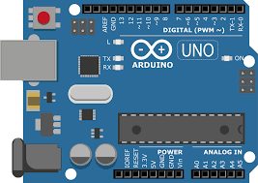
ARDUINO BOARD
This is the brain of whole project.
Each and every connection pass through this.
Arduino UNO is a microcontroller board based on the ATmega328P. It has 14 digital input/output pins (of which 6 can be used as PWM outputs), 6 analog inputs, a 16 MHz ceramic resonator, a USB connection, a power jack, an ICSP header and a reset button.
It contains everything needed to support the microcontroller; simply connect it to a computer with a USB cable or power it with a AC-to-DC adapter or battery to get started

Slide 7
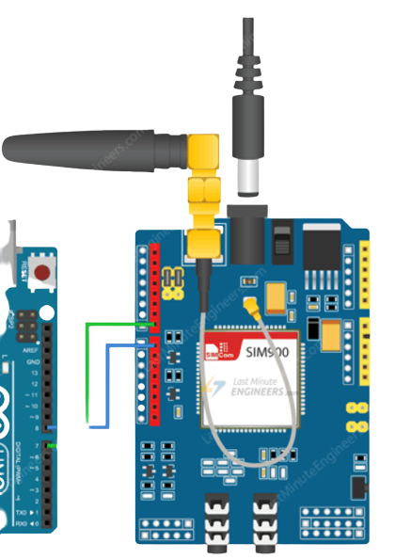




GSM
GSM modem or GSM module is a hardware device that uses GSM mobile telephone technology to provide a data link to a remote network.
From the view of the mobile phone network, they are essentially identical to an ordinary mobile phone, including the need for a SIM to identify themselves to the network.
GSM (Global System for Mobile Communications, originally Groupe Spécial Mobile), is a standard developed by the European Telecommunications Standards Institute (ETSI).

Slide 8
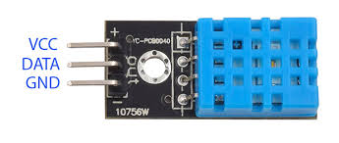

DHT11
It’s used to measure the humidity and temperature of our surrounding.
DHT11 Temperature & Humidity Sensor features a temperature & humidity sensor complex with a calibrated digital signal output.
DHT1 also contains a NTC/Thermistor to measure temperature.
A thermistor is a thermal resistor whose resistance changes drastically with temperature. The term “NTC” means “Negative Temperature Coefficient”, which means that the resistance decreases with increase of the temperature.

Slide 9
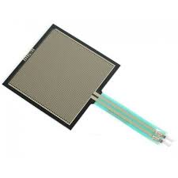
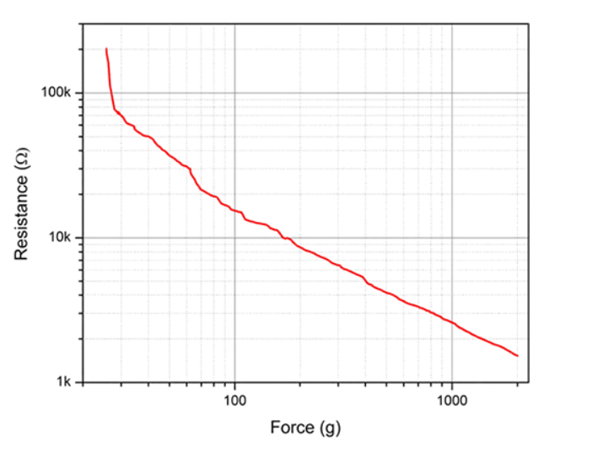
Force Sensor
Force Sensing Resistors are also known as Force Sensitive Resistors or Force Sensors or just FSRs.
They are low-cost and easy-to-use sensors specifically designed to detect physical pressure, squeeze, and weight.
An FSR is nothing but a variable resistor that varies in resistance as pressure is applied to the sensing area.

Slide 10
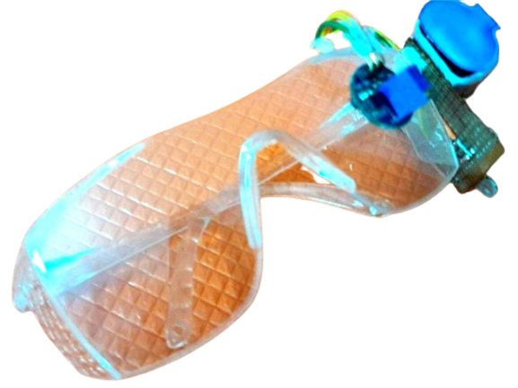
Iris Sensor
The basic purpose of this system is to track the driver’s eye movements using Eye blink Sensor.
And if the driver is feeling drowsy, then the system will trigger a warning message using a loud buzzer alert.
The eye blink sensor is used to detect the eye blinks and using which we can also detect the activities like the Drowsiness of the driver while driving. It works based on the technology of Infrared LED.
It contains an Infrared transmitter and Receiver LED which is used to detect the eye blink.

Slide 11
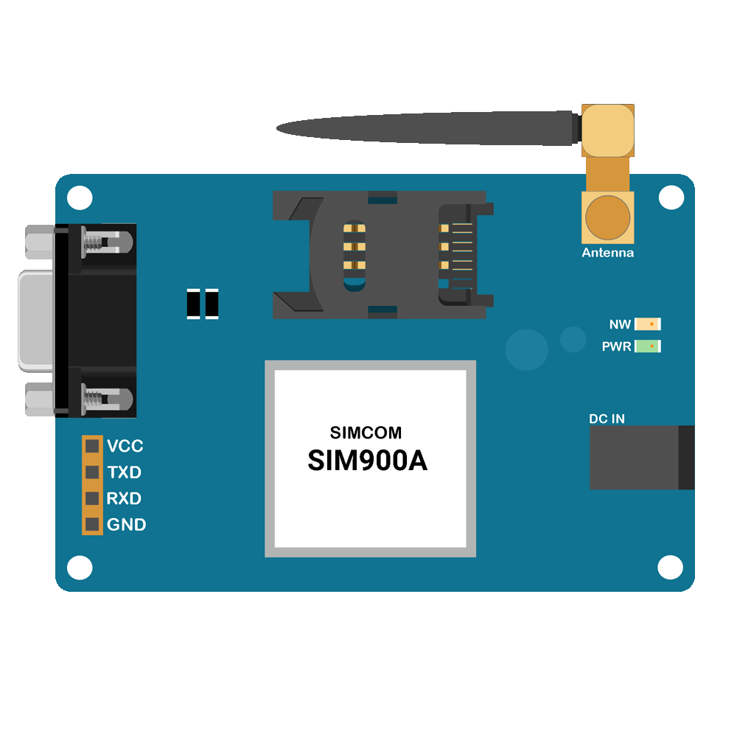


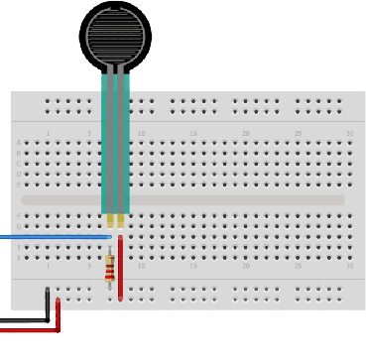
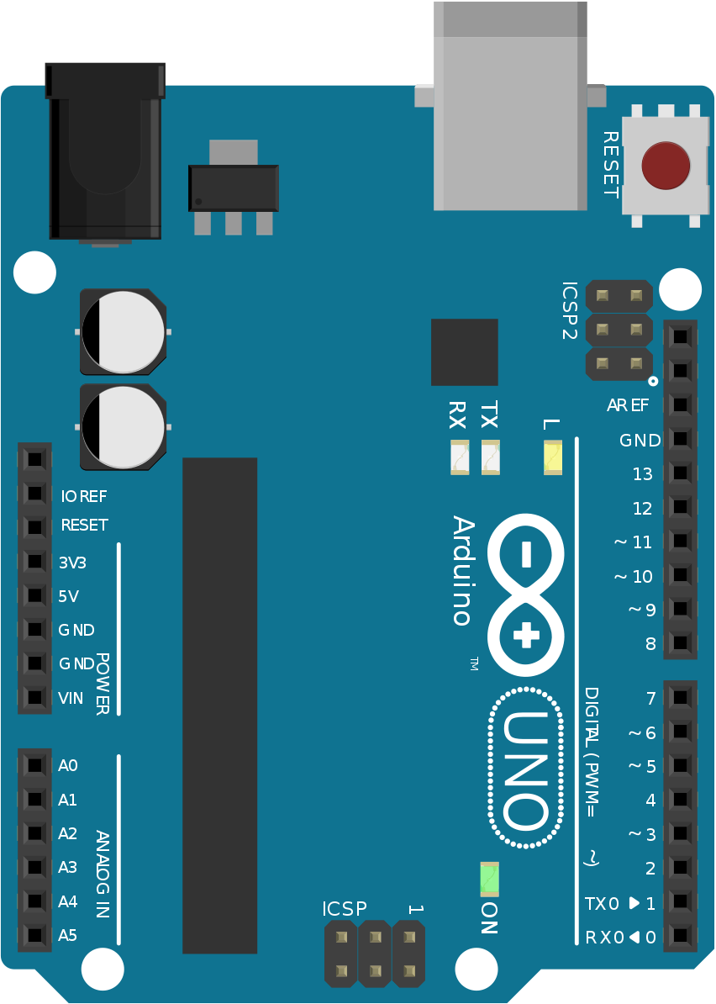
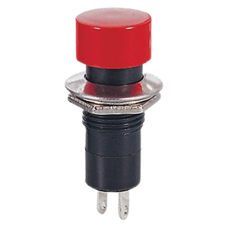
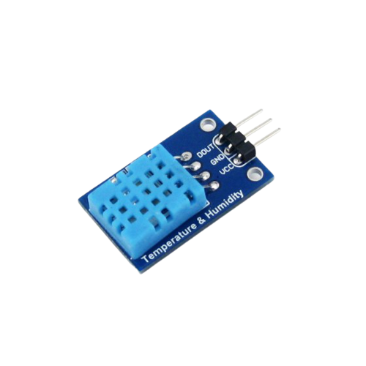
5v
op
GND
5V
GND

Slide 12

IF ACCIDENT HAPPENED
ACCIDENT SENSE BY SENSORS
SEND MESSAGES TO GIVEN NUMBERS
RESCUED!!

Slide 13
ADVANTAGES
1) If a person experiences drowsiness then IR Sensor detects the closed eyelids and buzzer starts buzzing after a gap of 2-3 seconds.
3) This is a low cost prototype which is easily available and manufactured.
2) We have a special feature that is only available in luxury cars nowadays that sends SMS to registered mobile numbers in case of emergency.

Slide 14
DISADVANTAGES
1) This is time consuming process and sometimes sensors are not accurate.
3) It get heats up when high voltage is applied.
2) The GSM module only works when it is connected to nearby network tower.

Slide 15

THANKS!

